Slide 1
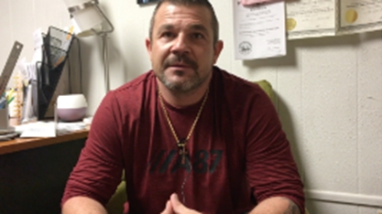

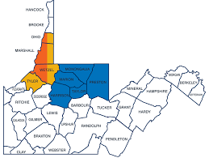
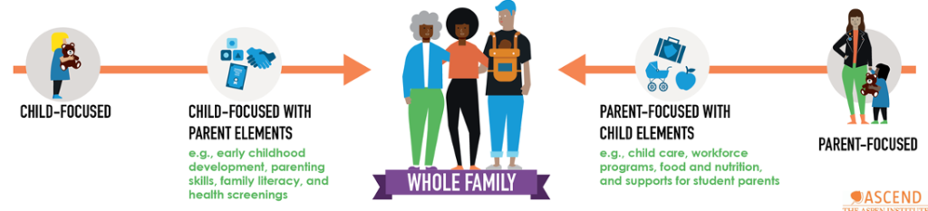

Scaffolded Inclusion of Local Peer Recovery Coach Model Into Care Coordination Program for Mothers and their Infants
Lesley Cottrell, PhD, Charlotte S. Workman, and Kayla Richard
West Virginia University, Department of Pediatrics¹ and Center for Excellence in Disabilities (CED)²
ABSTRACT
RESULTS
RESULTS AND DISCUSSION
Research has consistently supported the positive effects of Peer Recovery Coach models for substance use programs. However, research on the use and effectiveness of this model for women with substance use disorders who are mothers of young infants is limited. Furthermore, information on how to incorporate the peer recovery coach model into a larger service delivery program is needed. The IMPACT program in West Virginia (WV) focused on implementing two+-generational services to women who had engaged in substance use and given birth within the past three months. Program services available in a ten-county region in northern WV focused on the needs of the biological mother, caregiver of infant (if not mother), and infant. They were provided to: a) coordinate care; b) reduce duplication across providers; and c) establish a foundation of shared services. Adult education, employment, social services, and an array of health care services were offered to each family. Services were offered across four sites (i.e., a hospital, a family violence program, a home visiting program, and a family resource network). All sites coordinated services and captured information from enrolled families over the course of their involvement in the study (3-26 months). This study presents quantitative and qualitative analyses of the impact of introducing and continuing to include a peer recovery coach role in the program. Two of the four sites incorporated the peer recovery coach role within their service team. This informal team building process can be applied to similar situations, particularly in the rural setting with limited training for a practice being implemented by multidisciplinary teams. Analyses include data collected from September 2019 to August 2022. Our findings support the increased inclusion of the peer recovery coach in trainings offered to families and providers, in outreach and enrollment efforts, and in the implementation of interventions for high-risk women and their children. Our conclusions will support the contribution of this role in service delivery and identify specific areas in which the peer recovery model addresses service delivery gaps in the rural setting.
5 sites within the WV IMPACT network (court appointed agency, hospital, coordination center, home visiting program, community resource program)
  2 sites with peer recovery coach involved in direct service delivery
  1 site incorporating peer recovery coach in training
97 participants actively receiving services during data collection from September 1, 2021-September 30, 2022.
Peer Recovery Coach roles across sites (training, direct services, technical support) – see Figures.
Additional documented roles:
Sending emails to vulnerable groups about resources available – tailored outreach
Referrals for detox and other treatment
Coordinated services with patient navigator and career services
Crisis care and communication
In this underserved rural setting where substance use has increased over the past five years, it is important to coordinate the services that exist, identify ways to fill service gaps when presented, and reach those in greatest need.
Our findings support the need for Peer Recovery Coaches in a larger team of providers. These individuals:
Identify perhaps the most vulnerable portion of those to serve
Are available in high crisis moments
Have lived experiences and can connect easily; and
Can contribute their perspective to outreach and training efforts in a larger effort
As a result, sites that incorporated the Peer Recovery Coach perspective had greater outreach efforts, served more women and families in the community, and provided diverse training to a wider audience. Limitations noted at these sites included lower eligibility (filtering) abilities to start services and limited follow up. However, when combined with other services that could emphasize the long term follow up, the quality and sustainability of care was at the highest levels.
Connecting with Families and Training Others in the Workforce
Video: https://wvimpact.org/impact-services/ How do peer recovery coaches change lives?
Blogs https://wvimpact.org/blog/
  People sometimes just need someone to listen to them (Blog #1)
  Missed (Blog #2)
  Hello, My Name, is Brian (Blog #3)
  When I Met Amy (Blog #4)
ECHO Platform Case Discussions – Peer Support
Communities of Practice – Recovery Interventions and Success Stories
OBJECTIVES
The purpose of this study was to:
Review and discuss the peer recovery coach model
Apply the peer recovery coach model as it may be implemented in a larger community-based service and research program
Identify, compare, and discuss ways to incorporate and assess a peer recovery coach into existing programmatic activities.
Review and discuss mixed methods data captured with regards to the value of the peer recovery coach being a member of the larger service and research teams.
DIRECT SERVICE OUTREACH, ENROLLMENT, AND FOLLOW UP BY IMPACTWV SITE
REFERENCES
TFRN
Wheeling Hospital
METHODOLOGY
CASA, Inc.
Wheeling Hospital
Allen, L., Wodtke, L., Hayward, A., Read, C., Cyr, M. and Cidro, J., 2022. Pregnant and early parenting Indigenous women who use substances in Canada: A scoping review of health and social issues, supports, and strategies. Journal of Ethnicity in Substance Abuse, pp.1-31.
Farhoudian, A., Razaghi, E., Hooshyari, Z., Noroozi, A., Pilevari, A., Mokri, A., Mohammadi, M.R. and Malekinejad, M., 2022. Barriers and Facilitators to Substance Use Disorder Treatment: An Overview of Systematic Reviews. Substance Abuse: Research and Treatment, 16, p.11782218221118462.
Hennessy, E.A., Jurinsky, J., Simpson, H. and Nash, A., 2022. Parenting to provide social recovery capital: a qualitative study. Addiction Research & Theory, pp.1-7.
Hodges, M., Chambers, J.E., Denne, S., Wiehe, S.E., Tang, Q., Park, S. and Litzelman, D., 2022. Associations of Mental Health Measures and Retention in a Community-Based Perinatal Care Recovery Support Program for Women of Childbearing Age With Substance Use Disorder. Journal of Dual Diagnosis, pp.1-9.
Mckinney, J.R., Russell, M., Avellaneda-Ojeda, A., Gannon, C., Zambare, S., Hansford, M., Moukaddam, N. and Eppes, C., 2022. A Comprehensive Care Approach for Pregnant Persons with Substance Use Disorders. International Journal of Mental Health and Addiction, pp.1-12.
Peacock-Chambers, E., Buckley, D., Lowell, A., Clark, M.C., Friedmann, P.D., Byatt, N. and Feinberg, E., 2022. Relationship-Based Home Visiting Services for Families Affected by Substance Use Disorders: A Qualitative Study. Journal of Child and Family Studies, pp.1-13.
Ware, O.D., Buresh, M.E., Irvin, N.A., Stitzer, M.L. and Sweeney, M.M., 2022. Factors related to substance use treatment attendance after peer recovery coach intervention in the emergency department. Drug and Alcohol Dependence Reports, 5, p.100093.
CED
BUMFS
CASA, Inc.
TFRN
Team
  Demonstration Site 1: CASA, Inc.
  Demonstration Site 2: Wheeling Hospital
  Coordinating Center 3: Morgantown, WV
  Demonstration Site 4: Burlington United Family Services
  Demonstration Site 5: Taylor Family Resource Network
Participants
  Women who have experienced, or are experiencing substance use with infant (0-3 months)
  Kinship care (as introduced) support
  Providers
Training Initiatives
  Modules for providers and families
  Blogs
  Communities of Practice
  ECHO platforms
Direct Service Initiatives
  Two-generational services
  Care coordination
  Referral for service gaps
CED
BUMFS
BUMFS
Wheeling Hospital
TFRN
CASA, Inc.
TFRN
CASA, Inc.
Wheeling Hospital
CED
CED
BUMFS
ACKNOWLEDGEMENTS
Wheeling Hospital
BUMFS
This Appalachian Rural Health Integration Model (ARHIM) Program is supported by the Health Resources and Services Administration (HRSA) of the U.S. Department of Health and Human Services (HHS) as part of an award totaling $600,000 with 0 percentage financed with non­governmental sources. The contents are those of the author(s) and do not necessarily represent the official views of, nor an endorsement, by HRSA, HHS or the U.S. Government.
CASA, Inc.
TFRN
CED

